Slide 1
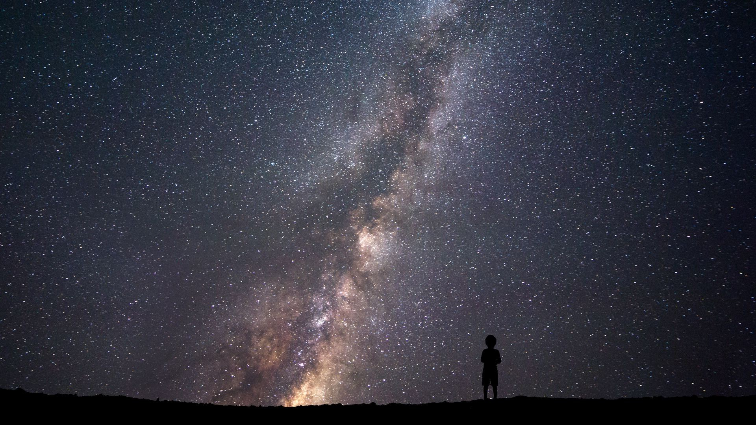

StarMobile
In the depths of space, where the stars shine with an ethereal glow, four military veterans found themselves at the helm of an extraordinary venture.
They dreamed of a galactic telecommunications company, one that would link the far-flung corners of the universe.
This is their story…
Josh, Hunter, Nasser, and Rod, each with their own scars from battles long past, shared a vision of connectivity that transcended planetary boundaries.

Slide 2



VetTech Java Cohort
Project 3 - StarMobile
Full Stack Application
Front-end: Angular 17
Back-end: Java 17 Spring Boot
Database: MySQL Workbench
Team Lead: Josh
Front-end Developer: Hunter
Back-end Developer: Abdelnasser
Database Developer: Rod

Slide 3
Overview
Functional Requirements
Non-functional Requirements
Development Requirements
UI/UX Requirements
Organizational Strategy
Distributed Responsibilities
Centralized Management

Slide 4

Development Process
Timeline
Database Development
Back-end Development
Front-end Development
Lessons Learned
Options for Improvement

Slide 5
StarMobile

